Slide 1
GBD: A Global-Scale Building Damage Dataset based on Diffusion Model
Presenter: Chen Zhenyuan (MSC 1)
Department: School of Earth Science, Zhejiang University
Date: 2024/4/25

Slide 2
Conception of Our Work
Abstract: ① Object Detection of Damaged Buildings in disastrous event is important for aiding and reconstruction. Current approaches for building damage assessment include CNN-based models and transformer-based models. ② However, these pre-trained model is still lack of general capability which fails to timeliness of detection in terms of disastrous events. ③ In this work, we propose a generative model ModelName to manufacture potential post-disaster images from vulnerable regions at global scale, be it GBD. ④ We find that after further training SOTA models on GBD, the performance of models show great improvements.

Slide 3
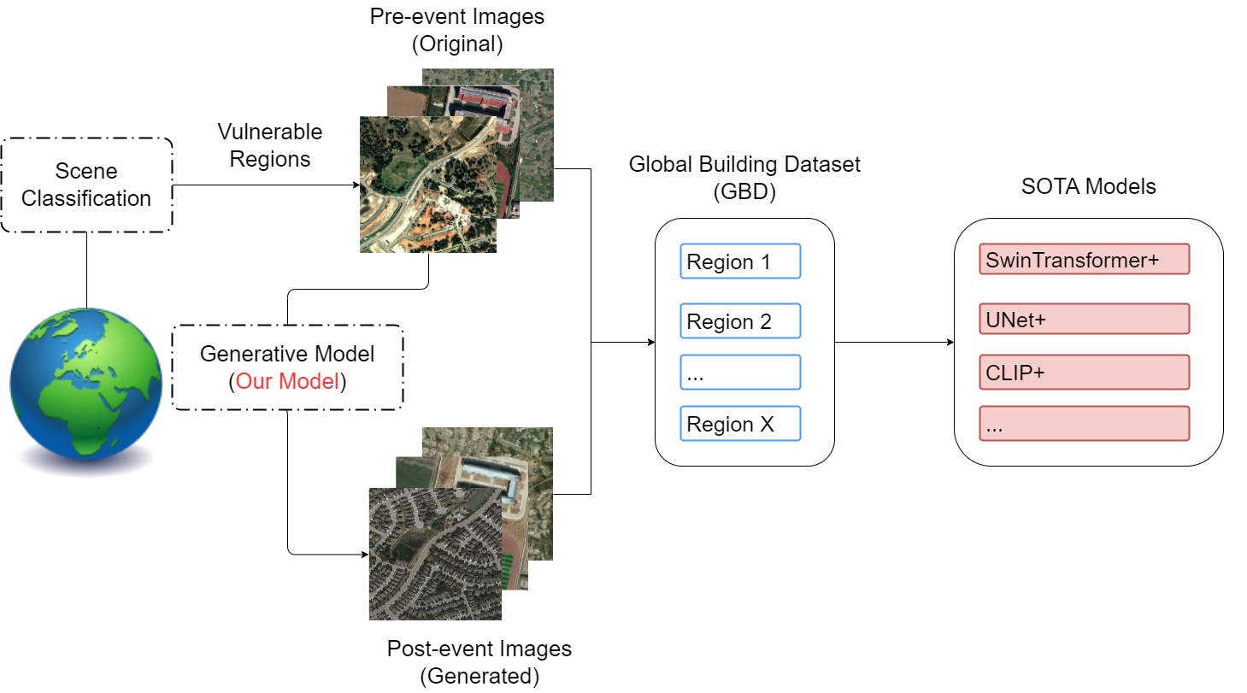
Framework
Pre-Training/Further-Training

Slide 4
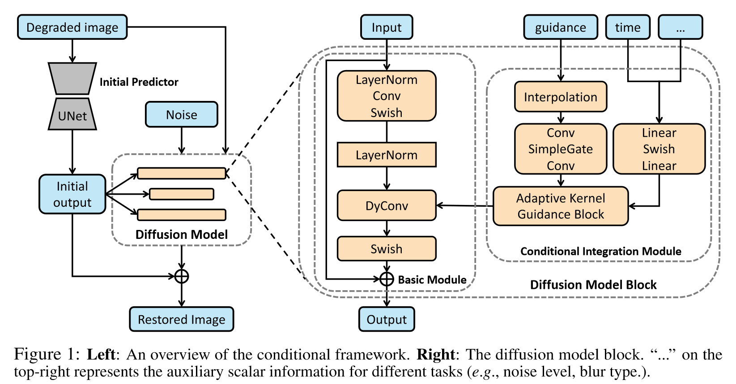
Architecture(ref)
Backbone Network: Unet(Learning Knowledge) + Diffusion(Generation)
Zhang, Y., Shi, X., Li, D., Wang, X., Wang, J., & Li, H. (2023). A Unified Conditional Framework for Diffusion-based Image Restoration. 37th Conference on Neural Information Processing Systems (NeurIPS 2023)

Slide 5
Background
Shortage of labeled building dataset at global scale.
The feature of remote sensing images on buildings varies greatly from here to there.
Pre-trained models strongly rely on domain-specific dataset for further training/supervised fine-tuning to improve the performance for specific downstream tasks.

Slide 6
Contributions
We propose a generative model to synthesize labeled building damage dataset.
SOTA models further train on our dataset shows considerable improvement in zero-shot for downstream tasks like segmentation, change detection and scene classification, especially in regions that has never been seen in the training dataset.

Slide 7
Future Work
Incorporated Language Model/Contextual Cues
A generalized model through Mixture of Experts/Modality Bridging

Slide 8
Related Work
Building Extraction in Disastrous Events
Earthquake (Wang et al., 2012)
Tsunami (Endo et al., 2018)
War conflict (Fakhri et al., 2021)
Generative Models for Remote Sensing Images (TGRS 2024)
Change Detection (Wen et al., 2024)
Foundation Model (Dong et al., 2024)
..(Zhang et al., 2024)

Slide 9
References
Wang, T.-L., & Jin, Y.-Q. (2012). Postearthquake Building Damage Assessment Using Multi-Mutual Information From Pre-Event Optical Image and Postevent SAR Image. IEEE Geoscience and Remote Sensing Letters, 9(3), 452–456.
Endo, Y., Adriano, B., Mas, E., & Koshimura, S. (2018). New insights into multiclass damage classification of tsunami-induced building damage from SAR images. Remote Sensing, 10(12), 2059.
Fakhri, F., & Gkanatsios, I. (2021). Integration of Sentinel-1 and Sentinel-2 data for change detection: a case study in a war conflict area of Mosul city. Remote Sensing Applications: Society and Environment, 22, 100505.
Wen, Y., Ma, X., Zhang, X., & Pun, M.-O. (2024). GCD-DDPM: A Generative Change Detection Model Based on Difference-Feature-Guided DDPM. IEEE Transactions on Geoscience and Remote Sensing, 62, 1–16.
Dong, Z., Gu, Y., & Liu, T. (2024). Generative ConvNet Foundation Model With Sparse Modeling and Low-Frequency Reconstruction for Remote Sensing Image Interpretation. IEEE Transactions on Geoscience and Remote Sensing, 62, 1–16.
Zhang, H., Wen, S., Wei, Z., & Chen, Z. (2024). High-Resolution Feature Generator for Small-Ship Detection in Optical Remote Sensing Images. IEEE Transactions on Geoscience and Remote Sensing, 62, 1–11.

